Slide 1
AI-POWERED SKIN CANCER CLASSIFICATION: A VGG-19 AND FEATURE OPTIMIZATION APPROACH
PRESENTED BY: N. Neeraj Emanuel (2022115122), A. Sujith (2022115312) & Vishnu Prasadh (2022115302)
MENTORS: Dr. N. Thangaraj & Dr. K. Arul Deepa

Slide 2
PROBLEM STATEMENT
High-quality, annotated datasets for training deep learning models are often scarce, which can impact model performance.
Some skin cancer types are rarer than others, leading to imbalanced datasets that may bias the model towards more common classes.
Deep learning models, especially with small datasets, may overfit, reducing their generalization ability on new images.
Handling patient data requires stringent security measures to prevent unauthorized access and ensure compliance with healthcare regulations.

Slide 3
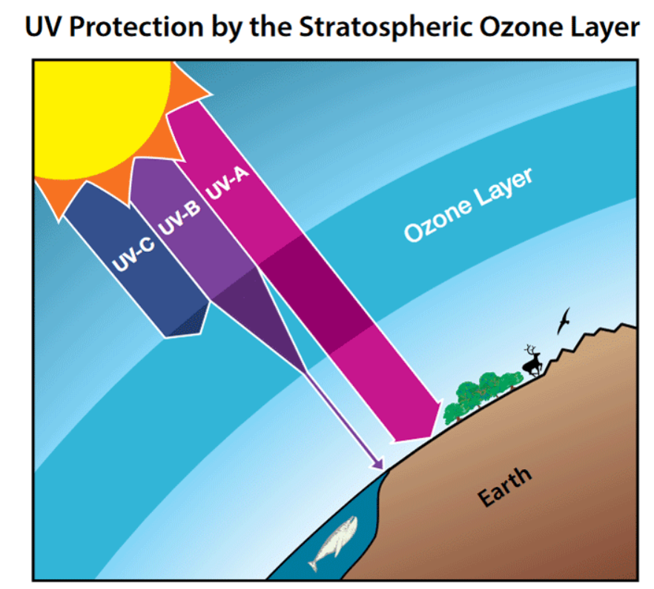
SOCIAL RELEVANCE
Reduced ozone levels as a result of ozone depletion means less protection from the sun’s rays and more exposure to UVB radiation at the Earth’s surface.
IMPACT ON HEALTH
Early detection & treatment of Skin cancer
Diagnostic capabilities are improved
Public health is improved
AI-driven assessments reduce the possibility of missed diagnoses and false positives
Environmental factors are also integrated into this approach

Slide 4
OBJECTIVES
To develop an AI-based system for accurately classifying skin cancer types (BCC, SCC, and Melanoma) using deep learning techniques.
To implement Adaptive Median Filtering, thresholding with Gray Level Co-occurrence Matrix (GLCM), and VGG-19 for improved feature extraction and classification accuracy.
To ensure early detection and diagnosis in remote or resource-limited areas, reducing dependency on dermatologists and enhancing accessibility.
To create a cost-effective and scalable AI-based diagnostic tool that supports telemedicine applications, enabling remote diagnosis and second opinions from experts worldwide.

Slide 5
LITERATURE SURVEY
SL. NO | TITLE AND AUTHOR | METHODOLOGY USED | ADVANTAGES | DRAWBACKS
1. | ‘Skin Cancer Detection Using Combined Decision of Deep Learners’ & Azhar Imran [2022] | A convolution-based deep neural networks is proposed for skin cancer detection. | This method provides a compelling reason to be applied for other disease detection. | Neural networks is have no clear understanding of the entity.
2. | ‘Multiclass skin cancer classification using Efficient Nets – a first step towards preventing skin cancer ’ & Karar Ali et al [2022] | This paper proposes Multiclass skin cancer classification using EfficientNets. | High classification accuracy Computationally efficient models Effective transfer learning capabilities | Complex model architecture selection Limited model interpretability

Slide 6
CONTINUED…
SL. NO | TITLE AND AUTHOR | METHODOLOGY USED | ADVANTAGES | DRAWBACKS
3. | ‘A Novel Vision Transformer Model for Skin Cancer Classification’& Yang et al [2023] | This paper presents a novel method of classifying skin cancer in clinical skin images. | Pretraining on ImageNet reduces training time and enhances fine-tuning accuracy. | High computational demands make deployment challenging in low-resource settings.
4. | ‘A Deep Learning Approach for Skin Cancer Classification’& Gururaj et al [2023] | The system uses CNNs, DenseNet169, and ResNet50 for skin cancer detection and segmentation. | Enhances the ability to detect skin cancer at early stages, improving patient outcomes. | Preprocessing techniques like segmentation and dull razor require expertise and may be resource-intensive.

Slide 7
CONTINUED…
SL. NO | TITLE AND AUTHOR | METHODOLOGY USED | ADVANTAGES | DRAWBACKS
5. | ‘Exploring Nanocarriers as Treatment Modalities for Skin Cancer’ & Mohammad Adnan et al [2023] | Nanocarriers as Treatment Modalities for Skin Cancer is proposed in this paper. | Nanocarrier make drugs more effective by improving their stability and absorption. | Developing and producing nanocarrier-based treatments can be difficult.
6. | ‘Skin cancer classification using NASNet ’ & Mohammad Atikur Rahman et al [2024] | This paper proposes an optimized NASNet architecture, in which the NASNet model is enhanced with additional data and an additional basic layer that is employed in CNN is added. | NASNet models are relatively robust to changes in lighting, camera angles, or skin tone. | Training NASNet models computationally intensive and time-consuming.

Slide 8
INTRODUCTION
Skin cancer classification is a crucial process in dermatology that involves identifying and categorizing different types of skin cancer based on medical images, such as dermoscopic or histopathological images.
The three most common types of skin cancer include basal cell carcinoma (BCC), squamous cell carcinoma (SCC), and melanoma, with melanoma being the most aggressive and life-threatening form.
Traditional diagnosis relies on clinical examination and biopsy, but advancements in artificial intelligence (AI) and deep learning have significantly improved automated classification methods.
Traditional methods of skin cancer classification face several challenges that can hinder early detection and accurate diagnosis.

Slide 9
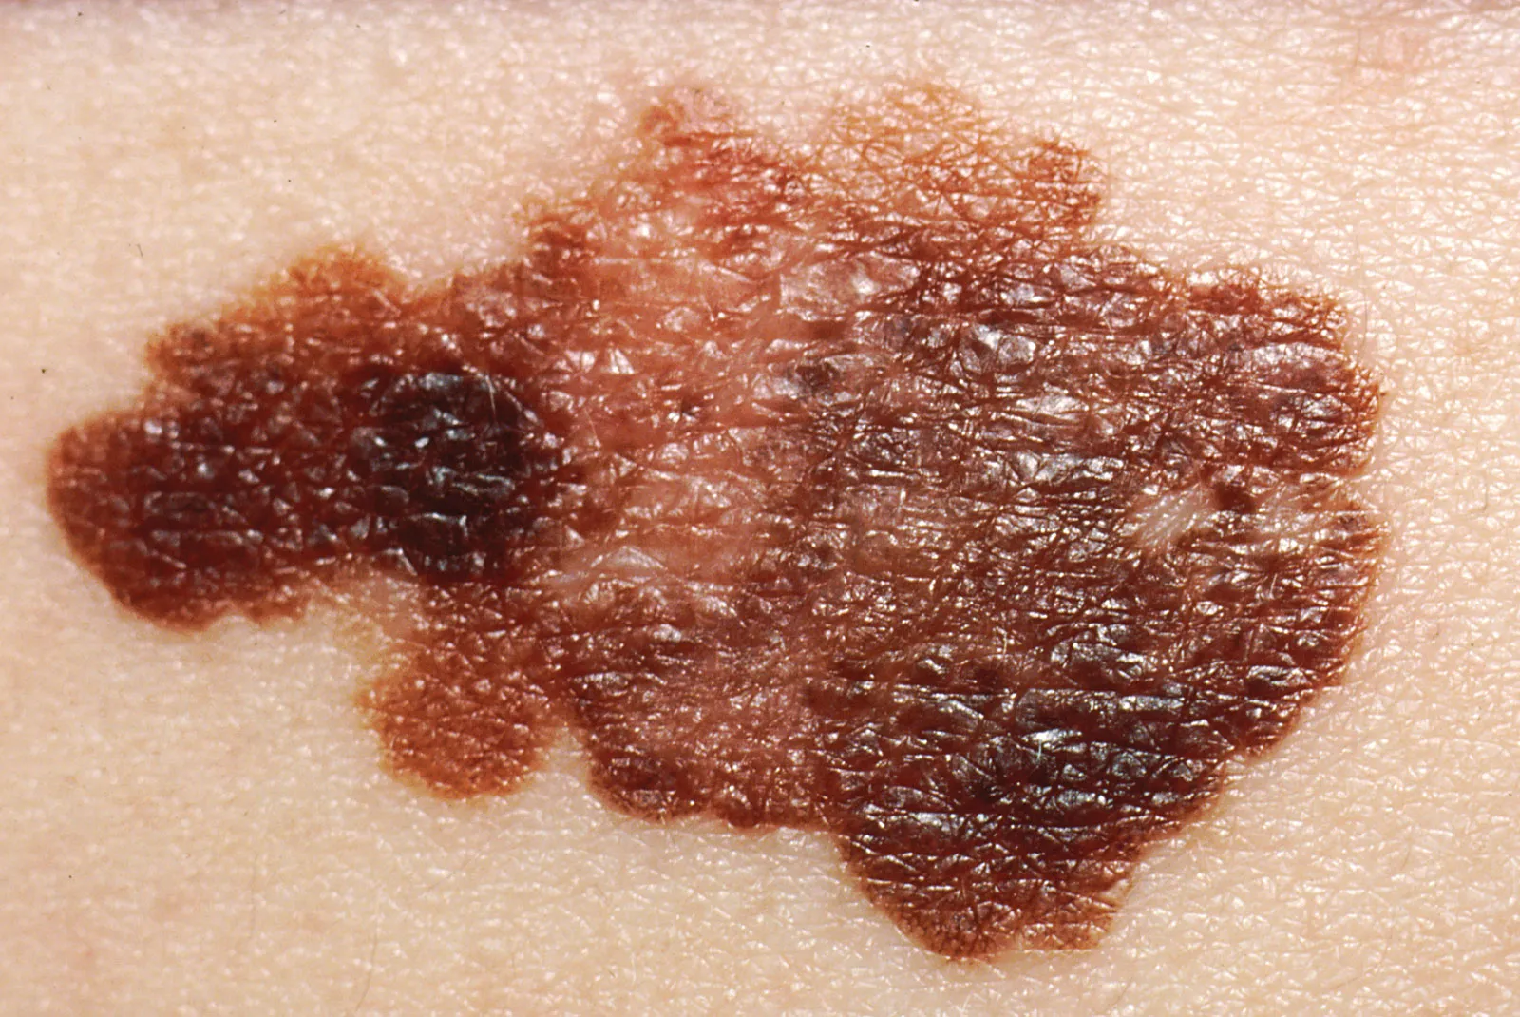
CONTINUED..

Slide 10
CONTINUED..
To address these challenges, this project proposes an AI-powered skin cancer classification system using a VGG-19 model combined with feature optimization.
The availability of dermatologists and specialized diagnostic facilities is also a concern, particularly in remote or underserved areas, where patients may face delays in receiving proper medical attention.
The increasing incidence of skin cancer requires faster and more scalable diagnostic solutions, which conventional methods may not adequately provide.
These challenges highlight the need for advanced, technology-driven approaches, such as AI-based skin cancer classification, to improve diagnostic accuracy, reduce dependency on invasive procedures, and enable early intervention.

Slide 11
EXISTING SYSTEM
Early melanoma diagnosis is enhanced through AI-driven analysis of environmental factors.
UVB exposure leads to DNA deterioration, forming photoproducts like CPDs and (6-4)PPS, which alter key genes.
UV-induced mutations accumulate over time, transforming normal melanocytes into malignant melanoma cells.
AI melanoma detection incorporates UV radiation, DNA damage, UV signature mutations, skin pigmentation, and melanin biochemistry.
AI enhances accuracy, customization, interpretability, and ethical adherence in melanoma detection.

Slide 12
CONTINUED
AI identifies high-risk populations and regions, aiding in early detection and prevention on a large scale.
Overexposure to UV radiation is a primary cause of the rising melanoma incidence since the mid-1960s.
Combining AI with digital dermoscopy and environmental insights improves melanoma diagnosis and public health outcomes.

Slide 13
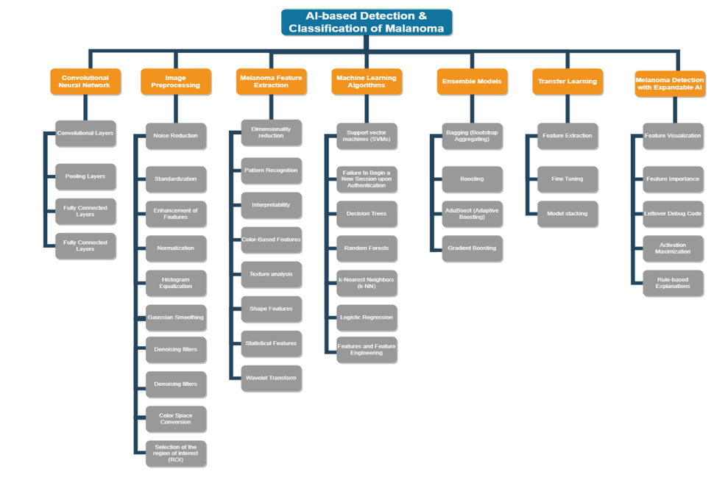
BLOCK DIAGRAM-EXISTING SYSTEM

Slide 14
DRAWBACKS
AI models, especially deep learning frameworks, demand significant computational power, making deployment challenging in resource-limited settings.
Deep learning models, such as VGG-19, function as black boxes, making it difficult to interpret how decisions are made.
Adoption in healthcare systems requires regulatory approval, training, and seamless integration with existing diagnostic practices.

Slide 15
PROPOSED SYSTEM
In this proposed system AI-powered skin cancer classification: a VGG-19 and feature optimization approach is proposed.
Skin cancer, including Basal Cell Carcinoma (BCC), Squamous Cell Carcinoma (SCC), and Melanoma, is primarily caused by excessive UV exposure.
Early detection is crucial for effective treatment. This project leverages AI to analyze UV-induced DNA damage, environmental factors, and skin pigment interactions for melanoma classification.
The methodology includes Adaptive Median Filtering for noise reduction, thresholding for segmentation, and VGG-19 for feature extraction and classification.

Slide 16
CONTINUED…
Flask enables real-time detection, while the Gray Level Co-occurrence Matrix (GLCM) enhances texture analysis.
Experimental results demonstrate the effectiveness of this approach in accurately identifying and classifying skin diseases, contributing to timely and efficient patient care.
This automated framework minimizes reliance on dermatologists, improving early diagnosis and accessibility.
Implemented in Python, it ensures efficiency and scalability.

Slide 17
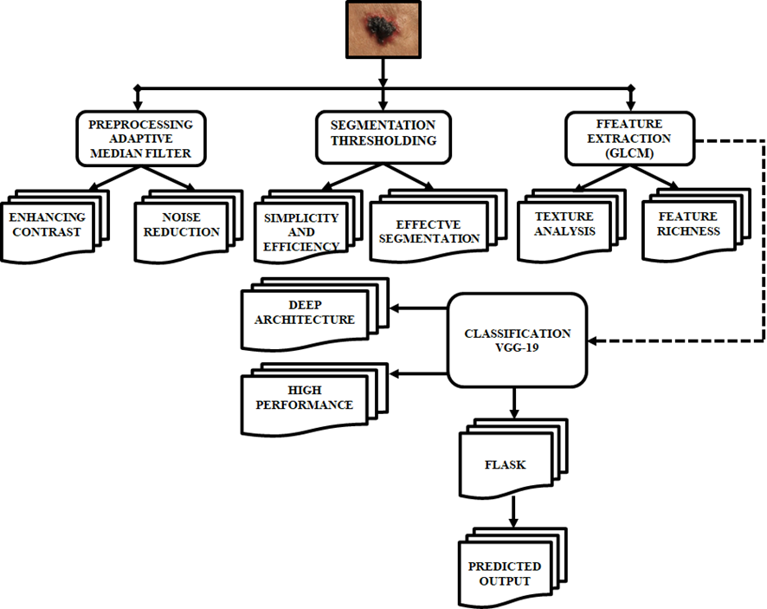
BLOCK DIAGRAM-PROPOSED SYSTEM

Slide 18
STAGES OF THIS PROJECT
Preprocessing (Adaptive Median Filter)
Segmentation (Modified-FCM)
Feature Extraction (GLCM)
Classification (VGG19)

Slide 19
PREPROCESSING
In the detection of skin diseases, preprocessing plays a crucial role in enhancing the quality of medical images for accurate analysis.
One commonly used technique is the Adaptive Median Filter.This filter works by preserving important details while effectively reducing noise in the image.
In the context of skin disease detection, this preprocessing step improves the clarity of dermoscopic images, making it easier for algorithms to identify patterns indicative of various skin conditions.
By reducing noise and enhancing relevant structures, the Adaptive Median Filter aids in improving the accuracy and reliability of subsequent diagnostic processes.

Slide 20
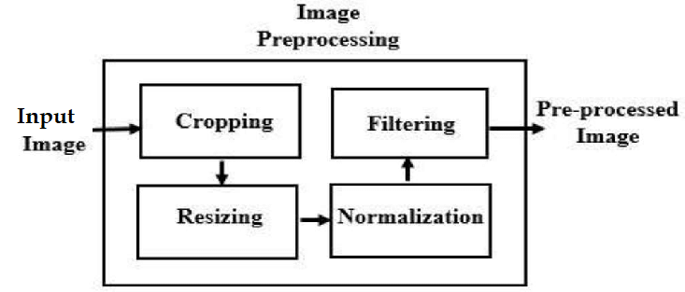
PREPROCESSING

Slide 21
SEGMENTATION (MODIFIED-FCM)
In the detection of skin diseases, segmentation plays a vital role in identifying and isolating affected regions within medical images, such as dermoscopic scans. One commonly employed technique is Thresholding.
Thresholding works by converting grayscale images into binary images based on a predefined intensity threshold. Pixels with intensity values above the threshold are classified as one region, while those below it form another. This method effectively highlights lesions and diseased areas by distinguishing them from healthy skin.
In the context of skin disease detection, thresholding segmentation enhances the visibility of affected regions, making it easier for subsequent analysis and classification. It simplifies image processing, ensuring precise identification of abnormalities for accurate diagnosis.

Slide 22
FEATURE EXTRACTION (GLCM)
In the detection of skin diseases, feature extraction plays a critical role in analyzing medical images to identify relevant patterns indicative of various conditions.One widely used technique for feature extraction is Gray-Level Co-Occurrence Matrix (GLCM) analysis.
GLCM quantifies the spatial relationships between pairs of pixels based on their gray-level values in an image.
By computing statistical measures such as contrast, homogeneity, energy, and entropy, it captures important texture information related to the structure and appearance of skin lesions.
In the context of skin disease detection, GLCM-based feature extraction helps differentiate between benign and malignant lesions, aiding in accurate classification and diagnosis.

Slide 23
CONTINUED…
In skin disease detection, GLCM analysis enables the extraction of discriminative features that characterize specific textural patterns in skin lesions associated with various conditions.
These extracted features, such as contrast, homogeneity, and entropy, serve as valuable inputs for classification algorithms, aiding in the accurate differentiation between benign and malignant skin lesions.
GLCM-based feature extraction enhances the diagnostic capabilities of medical imaging, contributing to early detection, precise classification, and improved patient outcomes in skin disease diagnosis.

Slide 24
CLASSIFICATION (VGG-19)
In the detection of skin cancer, classification is a crucial step in analyzing extracted features from medical images to determine the presence and type of the disease.
One effective approach involves utilizing convolutional neural networks (CNNs), such as VGG19.VGG19 is a deep CNN architecture known for its high accuracy and feature extraction capabilities, making it well-suited for medical image analysis, including skin cancer classification.
In the context of skin cancer detection, VGG19 is trained on a dataset of preprocessed and feature-extracted skin lesion images to learn discriminative patterns, enabling accurate classification of lesions as benign or malignant.

Slide 25
CONTINUED…
By leveraging its deep learning capabilities, VGG19 can effectively differentiate between benign and malignant skin lesions with high accuracy.
Its deep architecture allows for detailed feature extraction, enhancing its ability to generalize across diverse datasets.
VGG19’s robust performance in image classification makes it a valuable tool for real-time skin cancer diagnosis and monitoring, potentially facilitating early detection and timely treatment strategies.

Slide 26
SOFTWARE AND HARDWARE USED
SOFTWARE USED:
Anaconda Jupyter
Vs code
XHAMPP
LANUGAGE USED:
Back End: PYTHON
Front End: HTML,CSS,JAVASCRIPT
DATABASE: Mysql
HARDWARE USED:
System: Pentium IV 2.4 GHz.
Hard Disk: 200 GB.
Monitor: 15 VGA Colour.
Mouse :
Ram: 512 Mb.

Slide 27
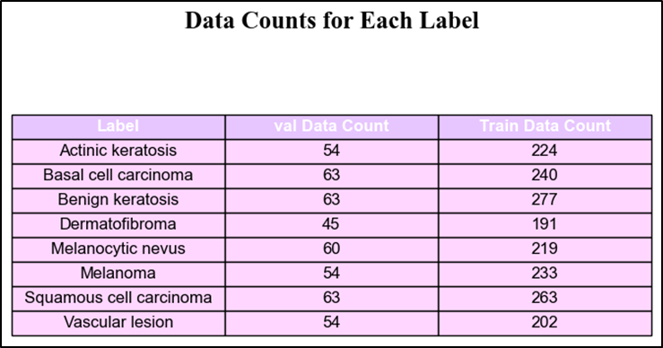
DATA COUNTS FOR EACH LABEL

Slide 28
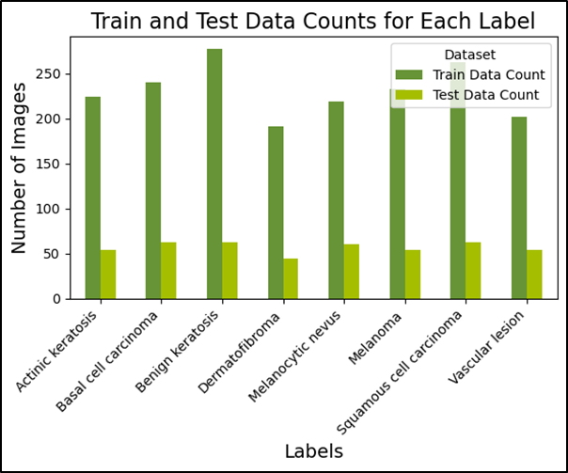
TRAIN AND TEST DATA COUNTS FOR EACH LEVEL

Slide 29
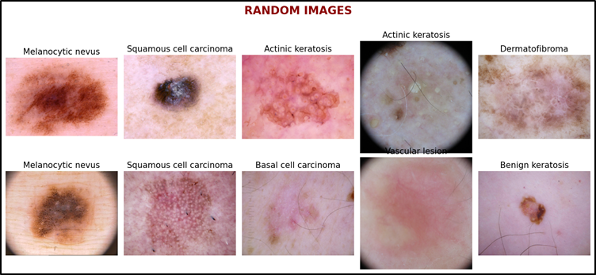
SKIN LESION IMAGES

Slide 30
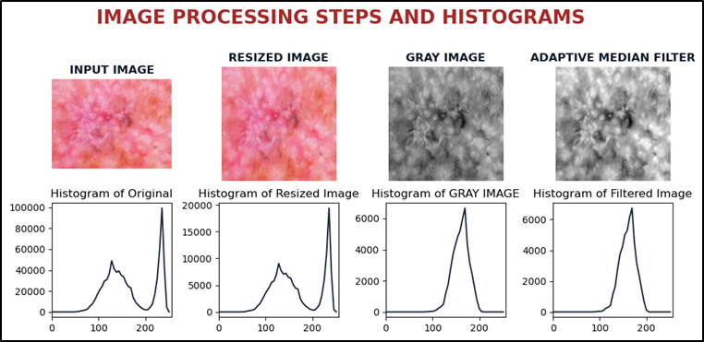
PREPROCESSING

Slide 31
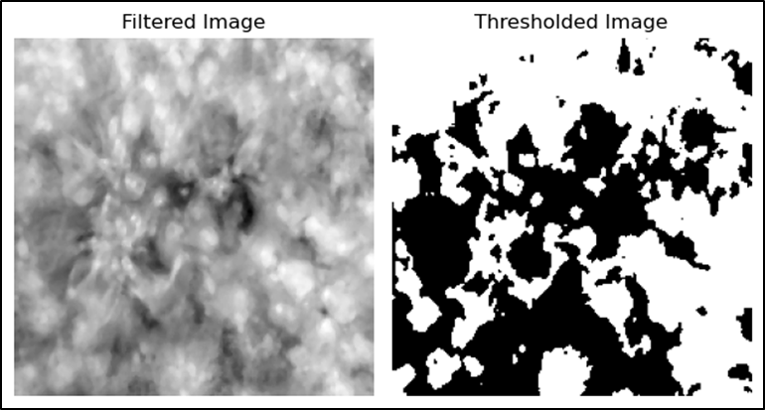
FILTERED IMAGE TO THRESHOLDED IMAGE

Slide 32
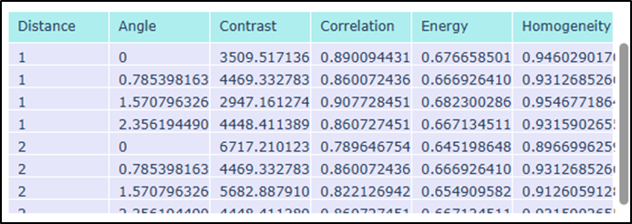
GLCM TEXTURE FEATURES TABLE

Slide 33
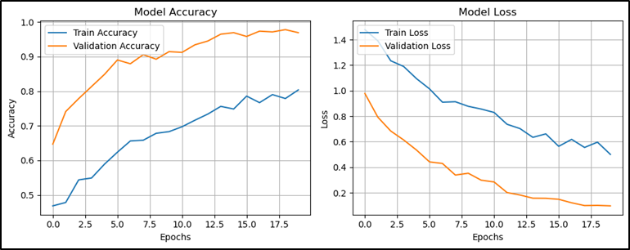
MODEL ACCURACY AND MODEL LOSS

Slide 34
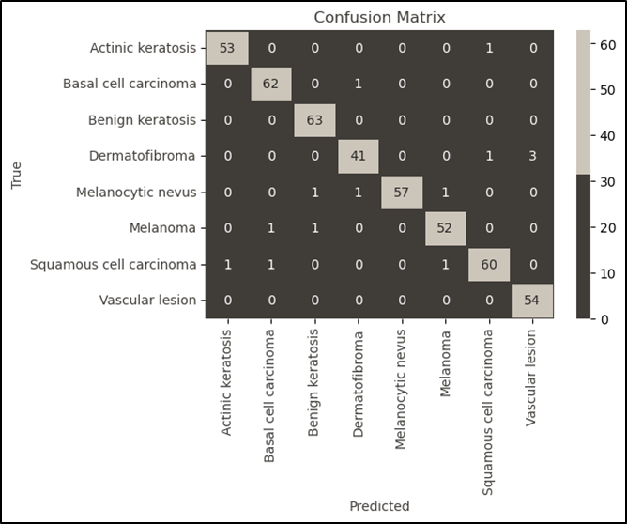
CONFUSION MATRIX

Slide 35
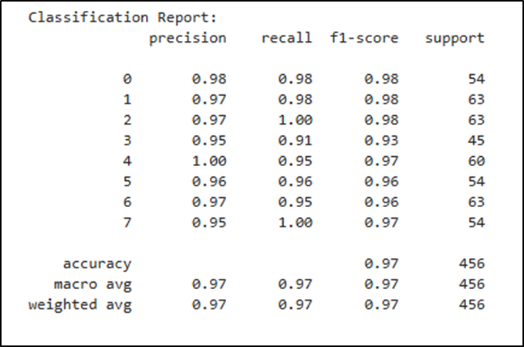
CLASSIFICATION REPORT

Slide 36
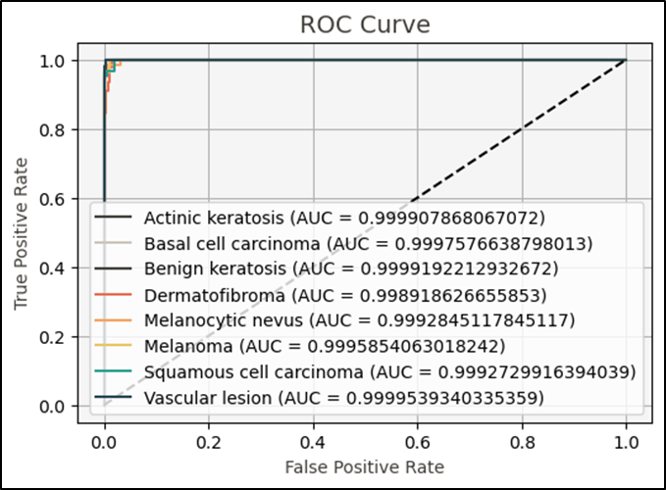
PREDICTED OUTPUT

Slide 37

HOME PAGE

Slide 38
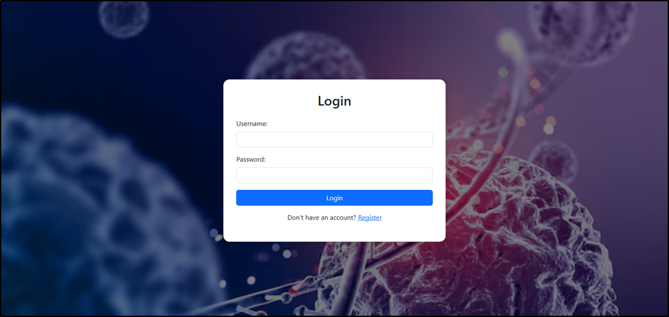
LOGIN PAGE

Slide 39
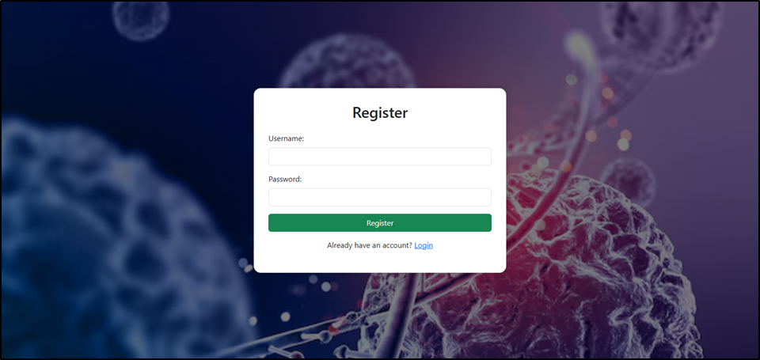
REGISTER PAGE

Slide 40
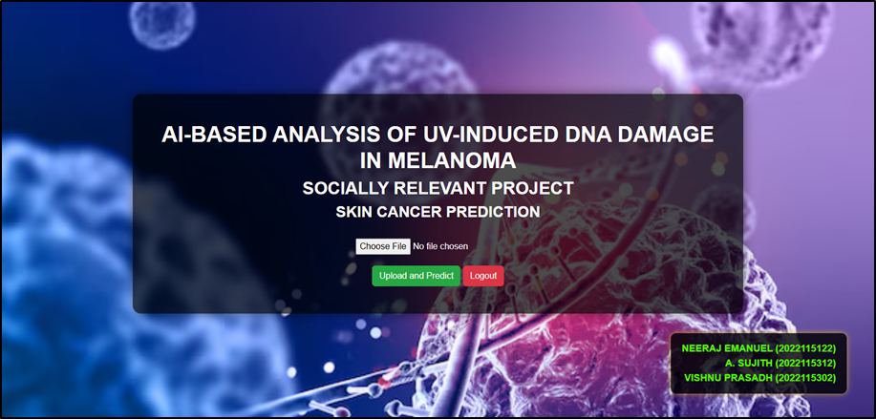
ANALYSIS PAGE

Slide 41
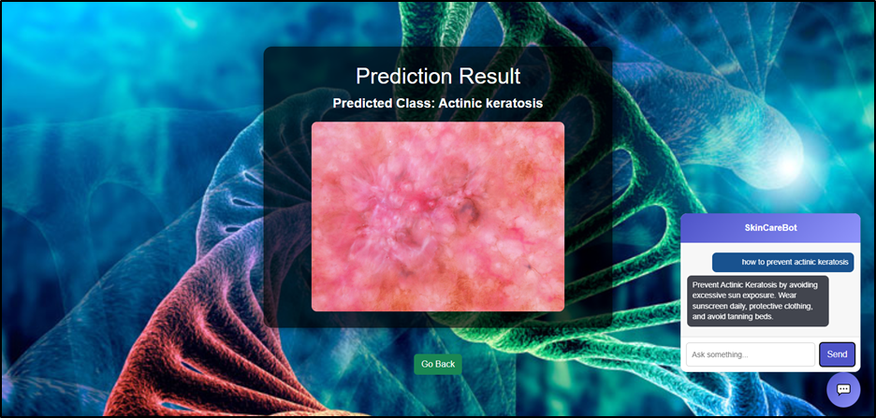
RESULT

Slide 42
ADVANTAGES
The system enables early identification of skin cancer, improving patient outcomes by facilitating timely treatment.
The use of Adaptive Median Filtering removes noise while preserving important features, leading to better diagnostic accuracy.
VGG19, a deep learning model, provides high accuracy in differentiating between benign and malignant skin lesions.

Slide 43
APPLICATIONS
Clinical Diagnosis Support
Remote Healthcare
Mobile Health (mHealth) Applications
Dermatology Research & Medical Studies

Slide 44
CONCLUSION
In conclusion, this study presents an AI-driven approach for the early detection and classification of skin cancer, integrating environmental factors, image processing techniques, and deep learning models.
The use of Adaptive Median Filtering enhances image quality by reducing noise, while thresholding improves segmentation efficiency.
VGG19 is employed for feature extraction and classification, ensuring high accuracy in distinguishing between different skin diseases.
Additionally, GLCM further refines texture analysis, enhancing diagnostic precision.

Slide 45
CONTINUED…
By deploying the system using Flask, real-time and automated skin disease detection is made possible, reducing dependency on manual diagnosis and enabling faster clinical decision-making.
Experimental results validate the effectiveness and reliability of the proposed framework in identifying and classifying skin diseases.
Ultimately, this project demonstrates the potential of AI-powered dermatological analysis to revolutionize early skin cancer detection, improve public health outcomes, and support scalable, cost-effective healthcare solutions.

Slide 46
REFERENCES
A. Imran, A. Nasir, M. Bilal, G. Sun, A. Alzahrani and A. Almuhaimeed, "Skin Cancer Detection Using Combined Decision of Deep Learners," in IEEE Access, vol. 10, pp. 118198-118212, 2022.
Ali, Karar, et al. "Multiclass skin cancer classification using EfficientNets–a first step towards preventing skin cancer." Neuroscience Informatics 2.4 (2022): 100034.
Yang, Guang, Suhuai Luo, and Peter Greer. "A novel vision transformer model for skin cancer classification." Neural Processing Letters 55.7 (2023): 9335-9351.
Gururaj, Harinahalli Lokesh, et al. "DeepSkin: a deep learning approach for skin cancer classification." IEEE access 11 (2023): 50205-50214.
Adnan, Mohammad, et al. "Exploring nanocarriers as treatment modalities for skin cancer." Molecules 28.15 (2023): 5905.
Rahman, Mohammad Atikur, et al. "Skin cancer classification using NASNet." International Journal of Science and Research Archive 11.1 (2024): 775-785.

Slide 47


